Slide 1
Team Lior :
World Data League 2021
Team members:
Steven Vuong (Team Leader)
Vinay Varsani
Hardique Manilal
Sachiyo Daley
Notes:
intro
on behalf of team lior to present
Our solution to
Churn model for public transports

Slide 2
Problem definition: Create a framework that will allow to measure the increase and decrease the passengers of public transport towards cities that are more inclusive and sustainable.
Notes:
Why it matterss
to measure the change passenger the uses PT among cities

Slide 3
DESIGN REQUIREMENTS
Objectives
Identify churn profiles and drivers, propose measures to win back lost segments
Constraints
public transports users’ profile in two periods,
the aggregated OD matrix,
and any other external or derived data,
Notes:
Measuere the passengers churn rate through a the model to id the key drivers of the distribution

Slide 4
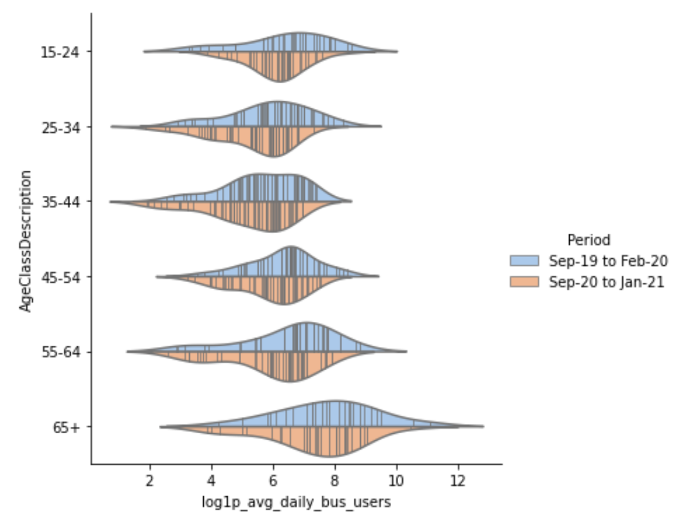
Churn User Profile Data

Slide 5
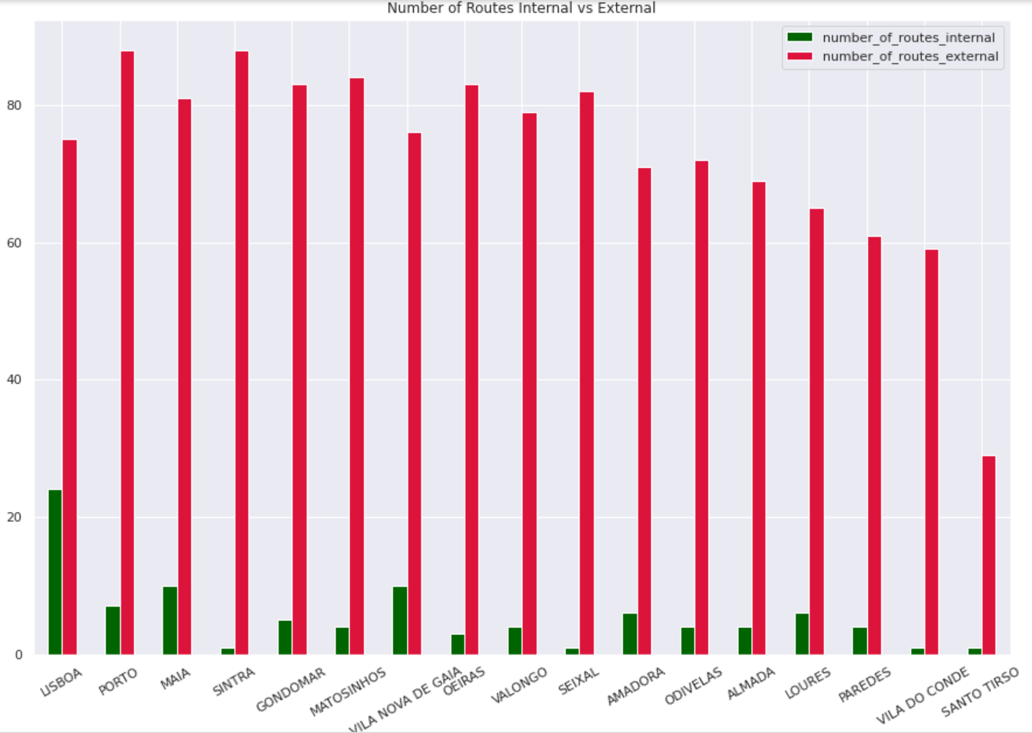
Churn Origin-Destination (OD) Data

Slide 6
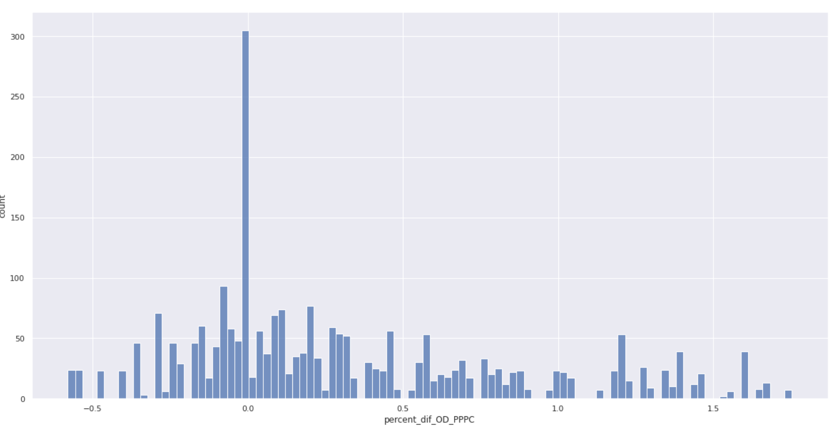
Data frame 3

Slide 7
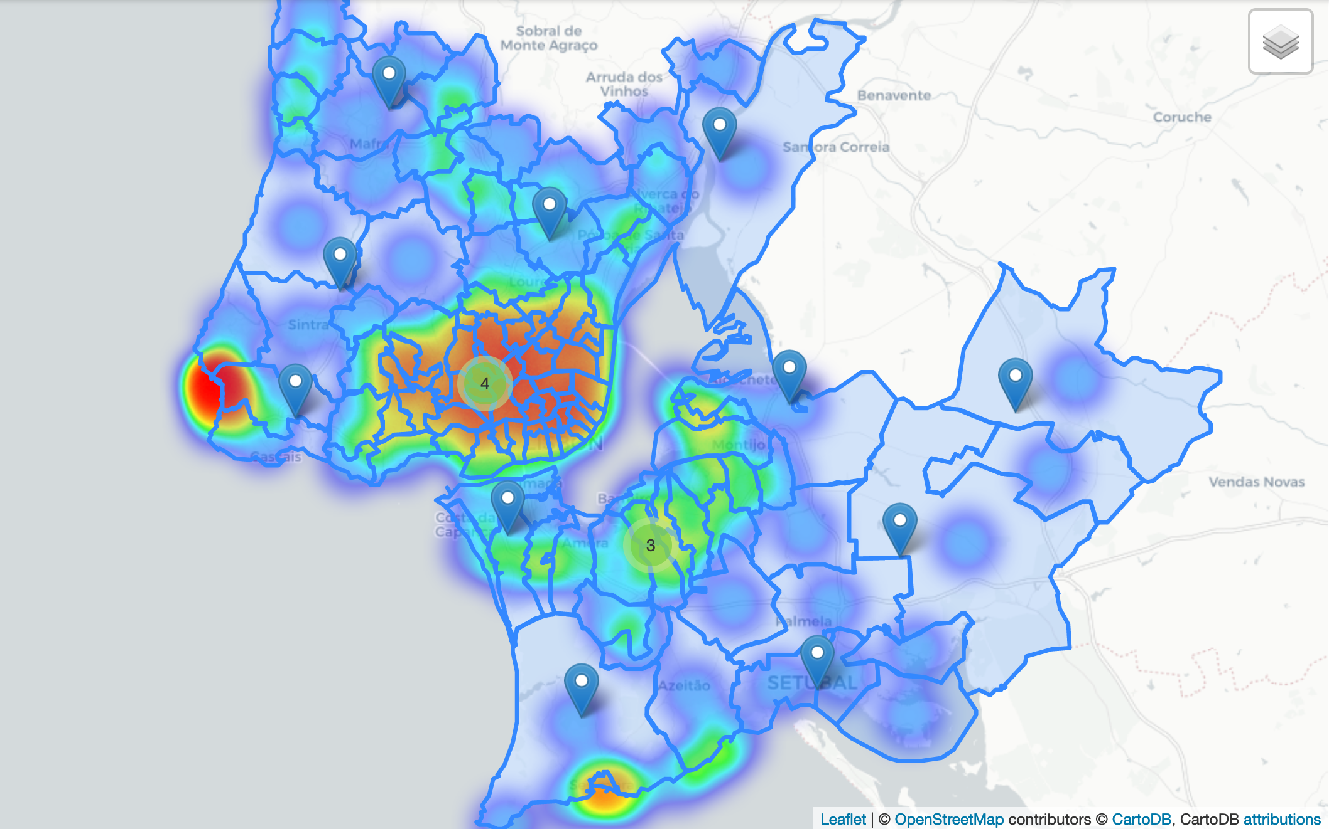
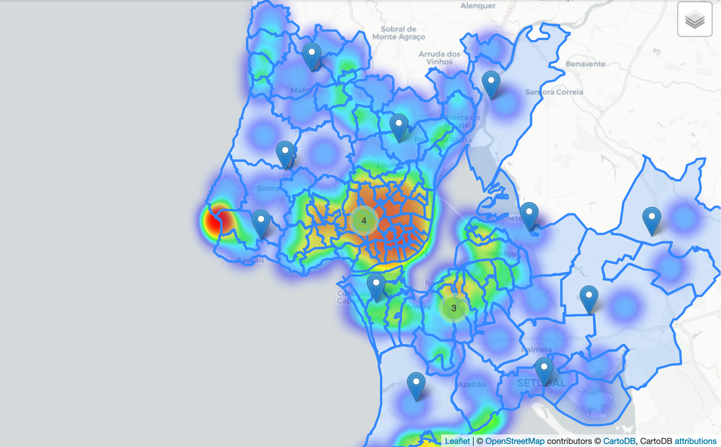
Heat map
Of Lisbon
At period 1
At period 2

Slide 8
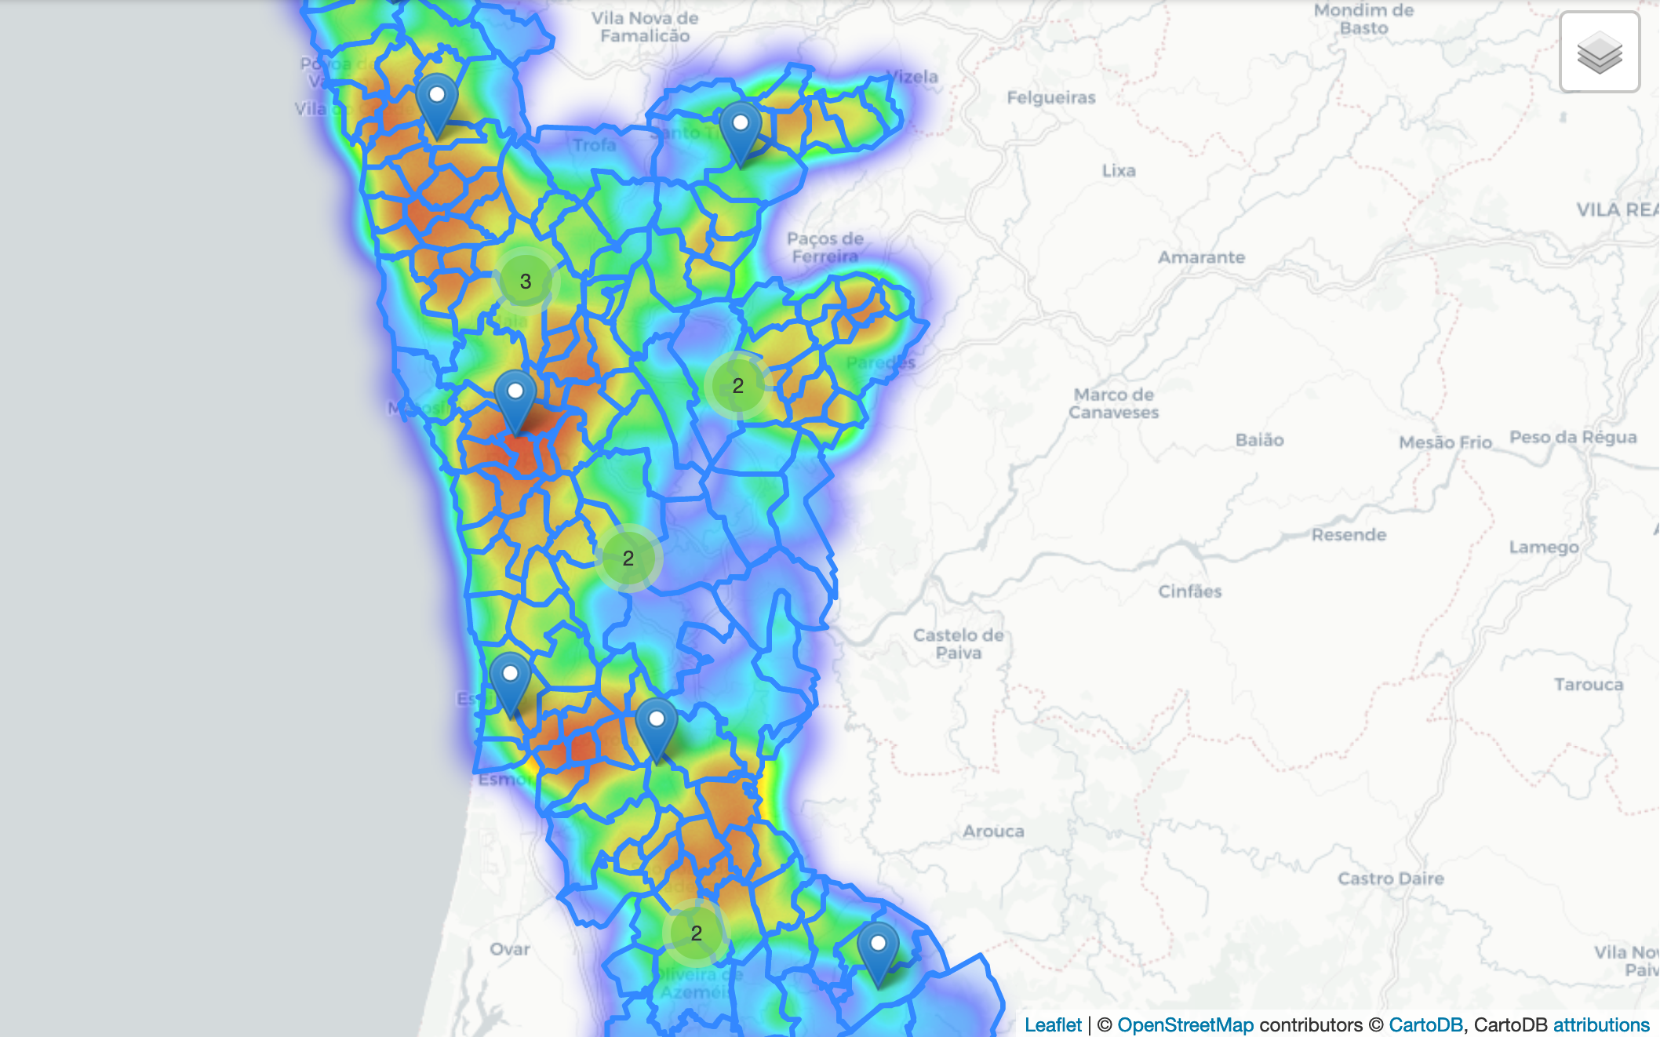
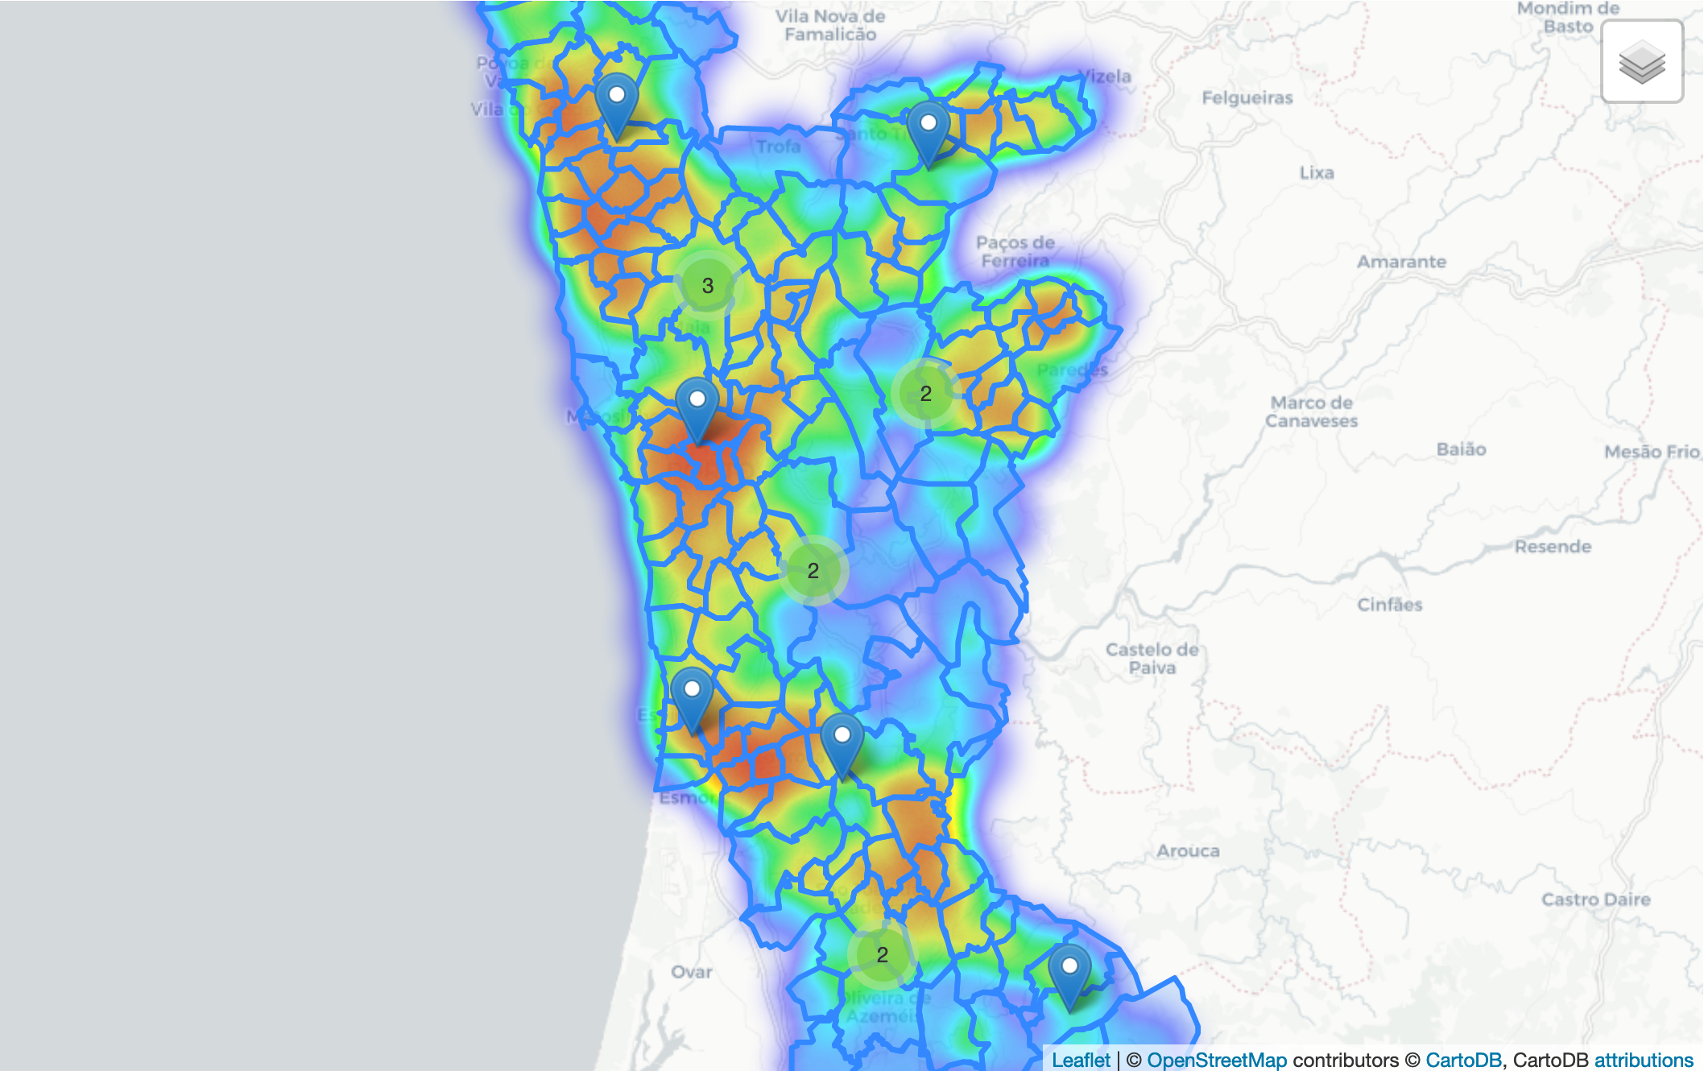
Heat map
Of Porto
At period 1
At period 2

Slide 9
Conclusion
1. Improve the image of public transport, from a last resort of transport to a reliable service the they can depend on a day to day life.
2. Adjust the post pandemic service to improve cleaning public transport
3. Intermodal solutions that need simplified as public transport service in Portugal is made up of buses, railway (subway, train, and tram), and ferry.
4. Service should be designed to accommodate the levels of service required by passengers (Reis, 2018)
Notes:
transport

Slide 10
Thank you for listing

